Slide 1
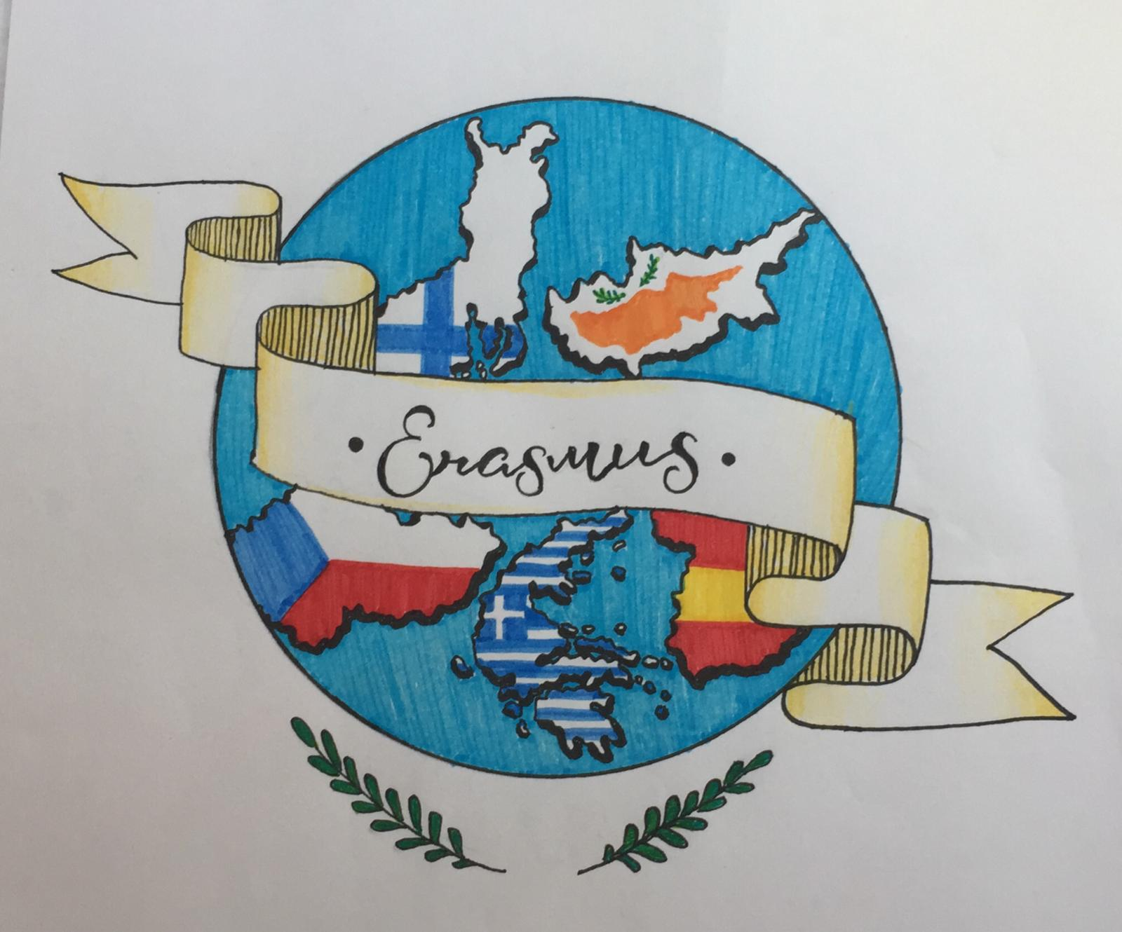
Bedřich Smetana, the founder of Czech national music
1824 - 1884

Slide 2
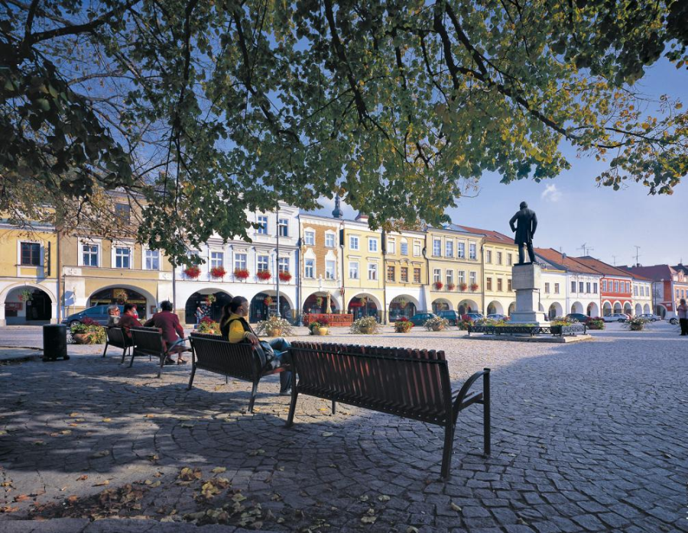
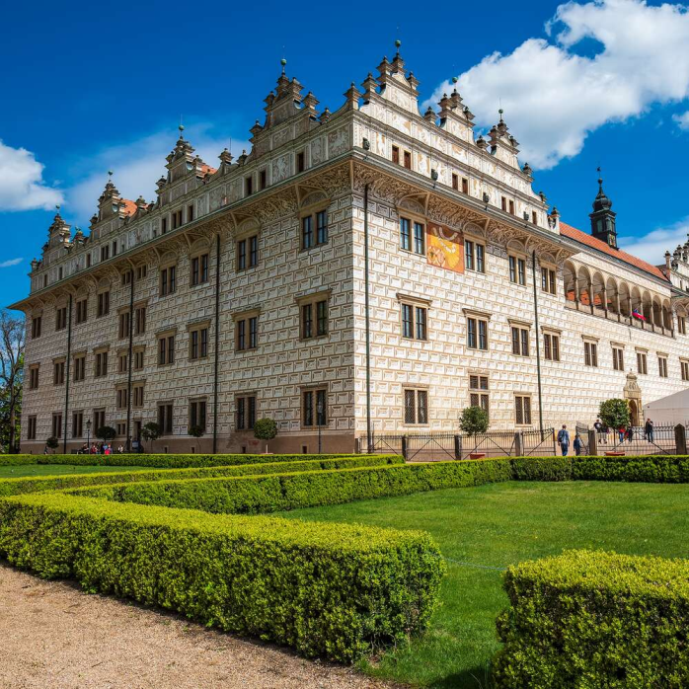
Litomyšl

Slide 3
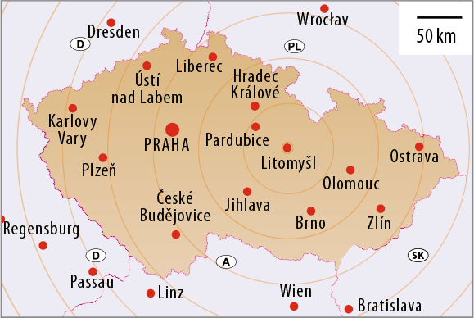
Litomyšl location

Slide 4
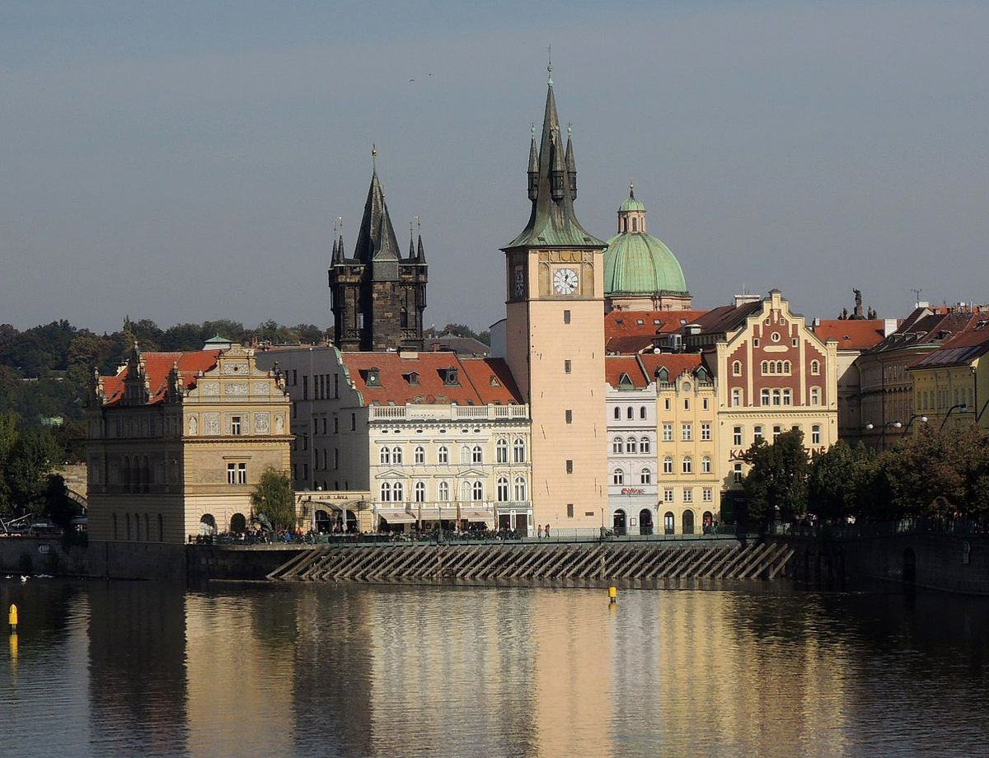
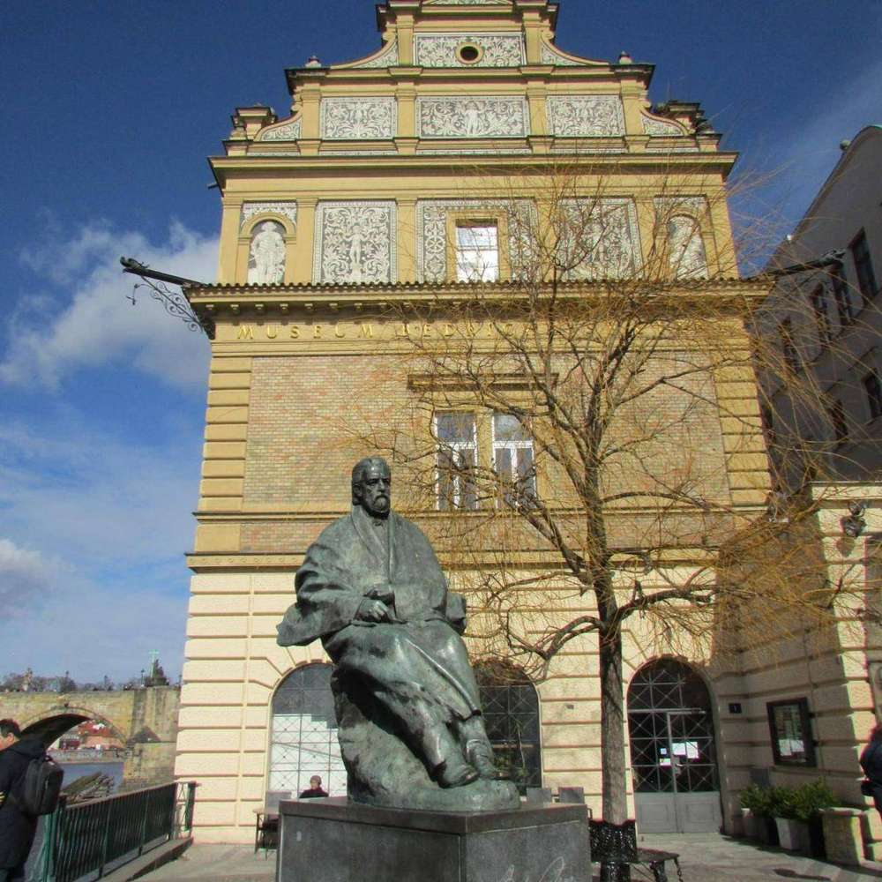
Statue of B. Smetany in Prague

Slide 5
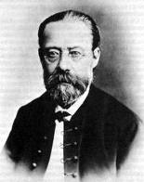
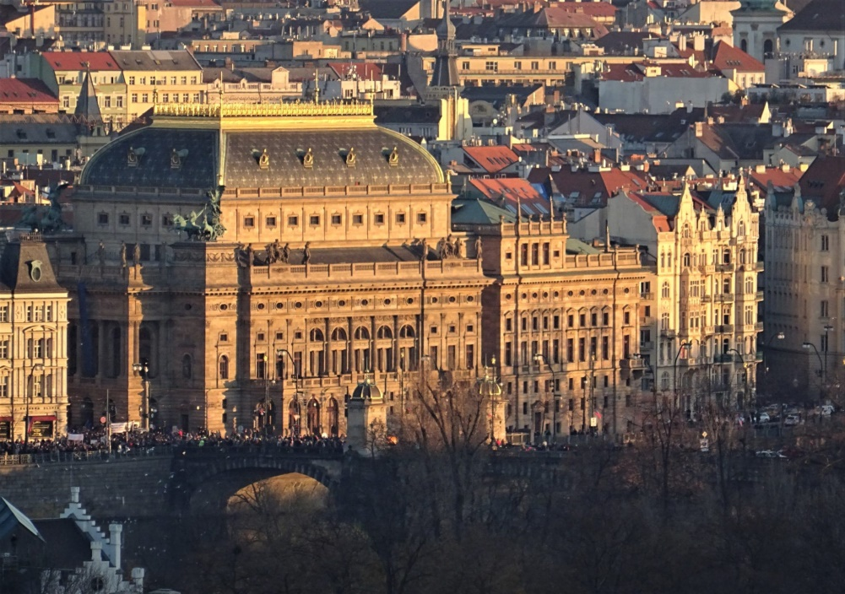
B. Smetana National Theatre

Slide 6
Vltava

Slide 7
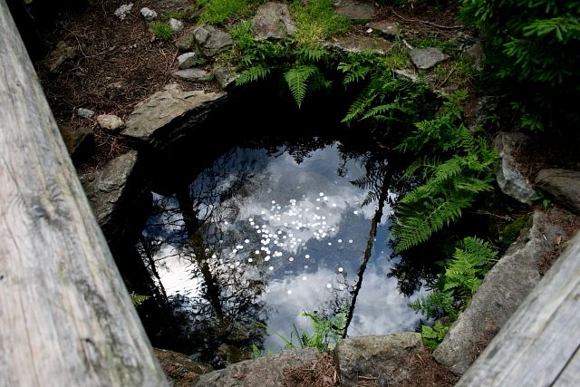
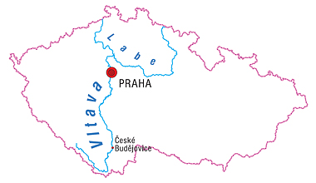
Headwaters of Vltava
„Hot“ Vltava- Šumava

Slide 8
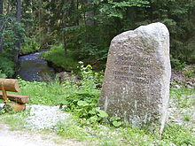
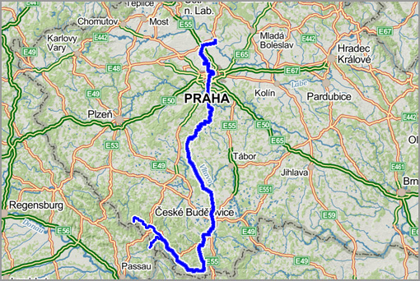
Headwaters of Vltava
„Cold“ Vltava- formed by the confluence of streams in Bavaria- Germany

Slide 9
Confluence of Hot and Cold Vltava

Slide 10
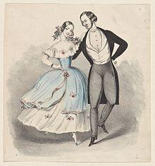
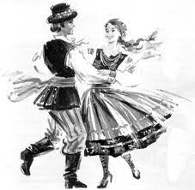
Polka
Czech national dance from the 19th century

Slide 11
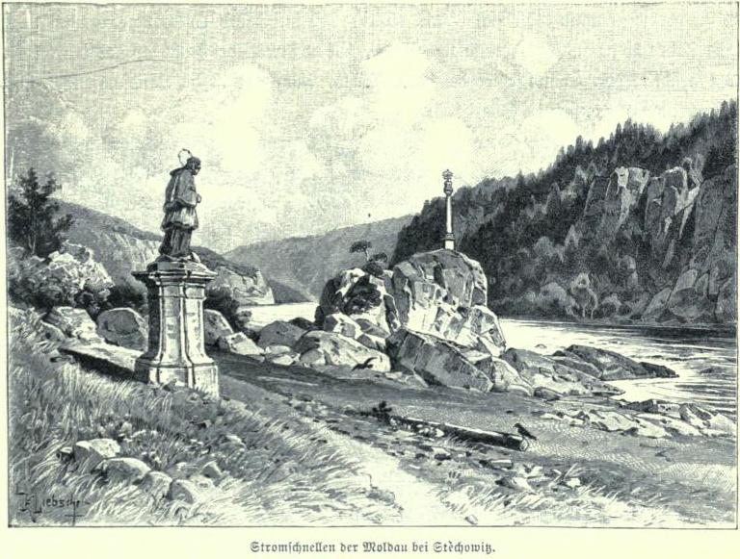
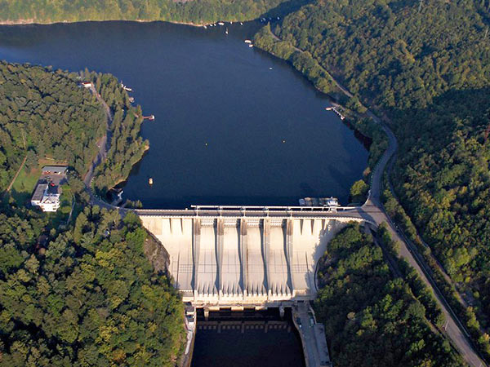
Midsummers currents- Svatojánské proudy
In the 19th century part of the Vltava with wildly flowing water
Today Slapy Dam- recreational area

Slide 12
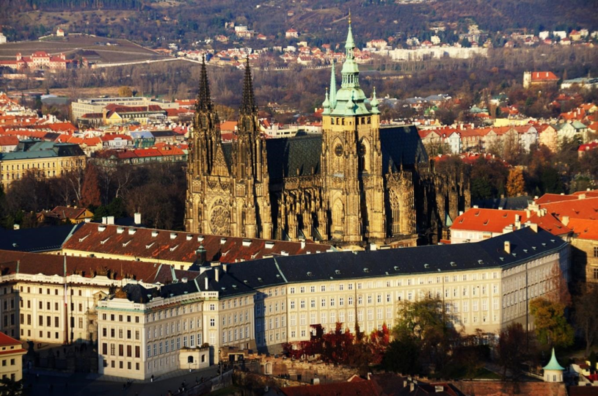
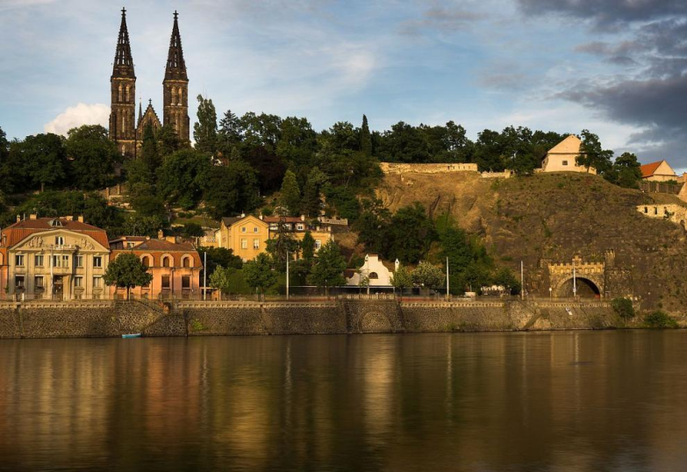
Vyšehrad
The second seat of Czech monarchs
Prague Castle
Vyšehrad

Slide 13
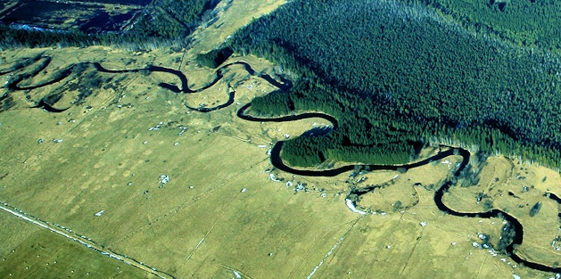
Listening to the Vltava:
The first source of Vltava – fine flutes accompanied by violin pizzicatos
„Second source“ – clarinet
„Vltava“ – Stream is powerful, a beautiful river will grow
„Forests – hunting “ – a fanfare of horns.

Slide 14
From Czech history…
„Polka“ - wedding rural festivities
„The river is moving away… the bass deep tones remained from the polka in the evening
„Moon – forest fairies“ – mysterious night – Bow instruments - pianissimo
„Dark outlines of old castles“ – famous medieval past of the Czech Republic

Slide 15
Vltava před Prahou
„Orchestra gradation“
„Svatojánské proudy“ = wild river
Svatojánské proudy
Slapy Dam

Slide 16
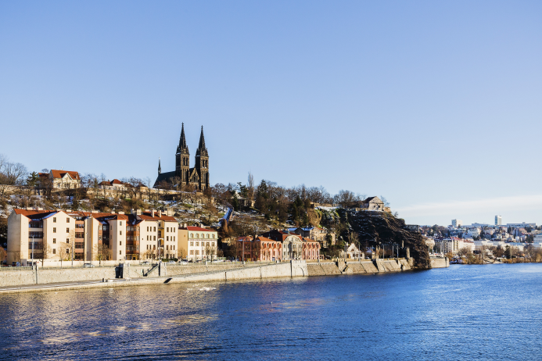
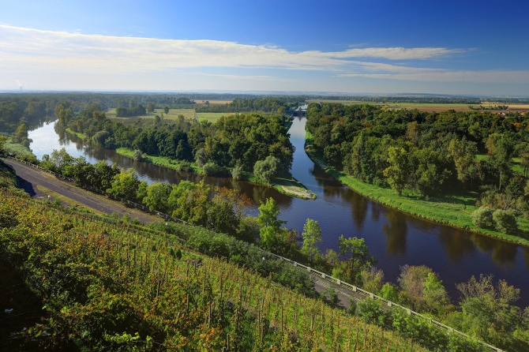
Vltava - Praha
„The wide Vltava River is heading towards Prague“ – from minor key to major- mood change
„Motive of Vyšehrad“
„ It disappears in the majestic Elbe“
Vyšehrad
Confluence- Vltava - Labe

Slide 17
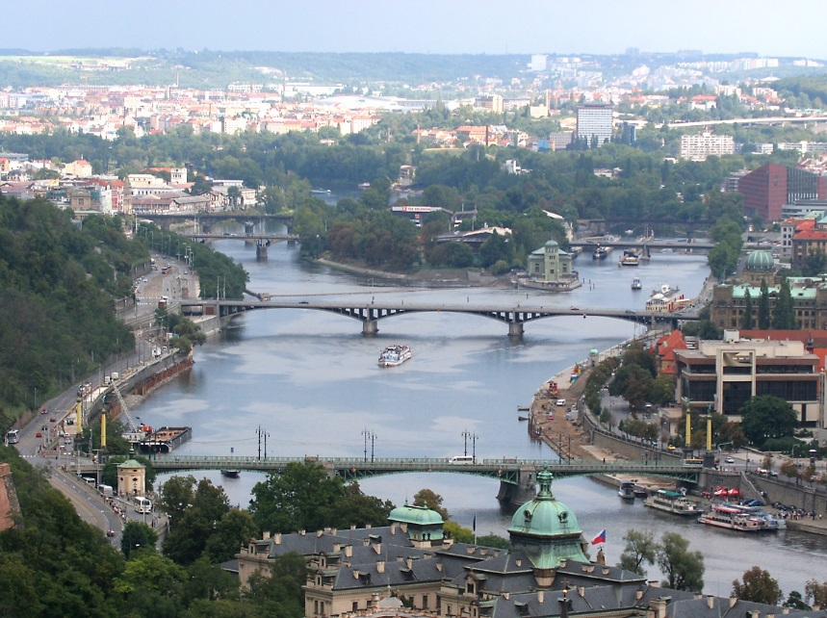
Vltava today

Slide 18
Kočka leze dírou
Kočka leze dírou pes oknem, pes oknem. Nebude-li pršet nezmoknem, nebude-li pršet nezmoknem.
A když bude pršet zmokneme, zmokneme. Na sluníčku zase uschneme na sluníčku zase uschneme.

