Slide 1
Industrialisation changes the way of life - Nokia as part of the development

Slide 2
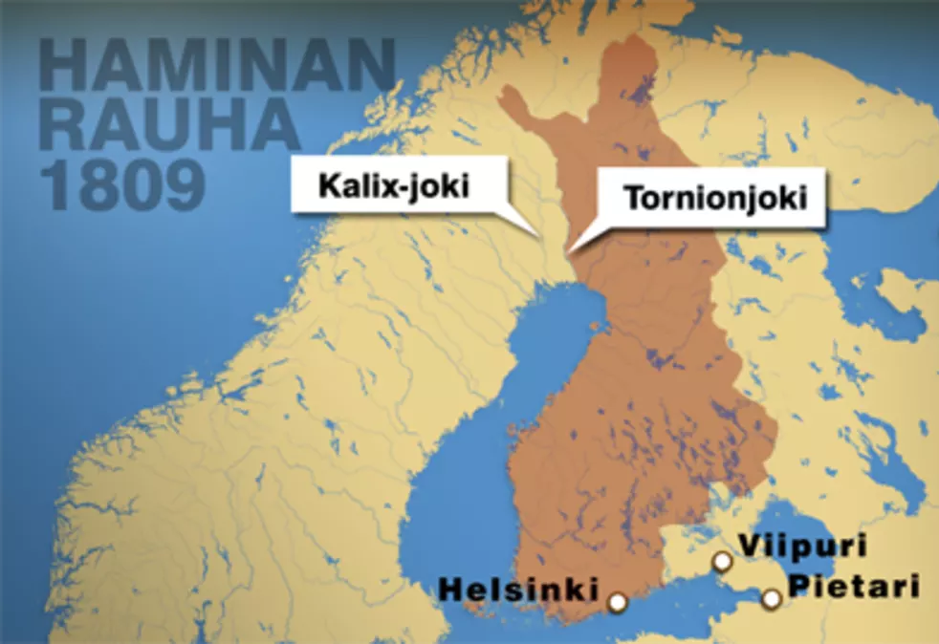
How was life in Finland in the 19th century?
Finland was eastern part of Sweden for many hundred years. Sweden and Russia had fought several wars during centuries.
After the Finnish war in 1809 Sweden lost its eastern parts of the North Sea to Russia. At this time Finland became an autonomous part of the Russian Empire as the Grand Duchy of Finland.
Finland was part of Russia until 1917.

Slide 3
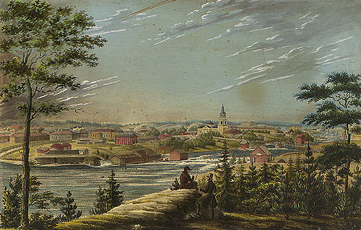
Finland was an agrarian country in the 19th century.
People farmed land, raised livestock and produced everything they needed themselves.
The 1860s saw the modest beginnings of the industrialisation and the first factories started up in the proximity of lakes and rivers.

Slide 4
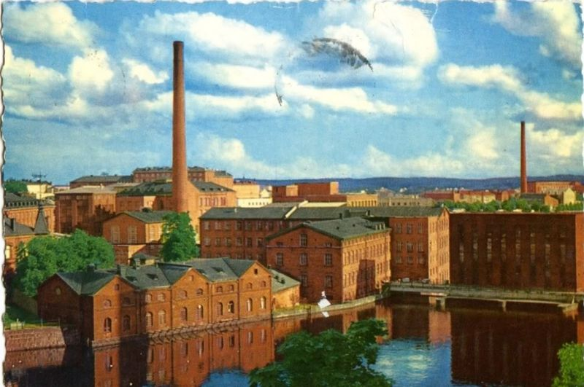
The city of Tampere developed into a significant industrial center.
The industrialisation started changing people’s lives:
machines were used to manufacture cheaper goods and the goods were paid money for.
The machines made the farm work easier.
There was a shift from subsistence economy to monetary economy.
Tampere old factories https://commons.wikimedia.org/wiki/File:Tampere_factories_pre-1965.jpg

Slide 5
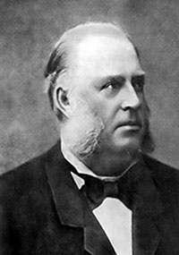
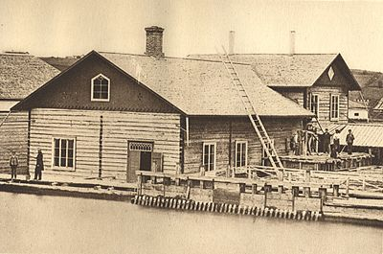
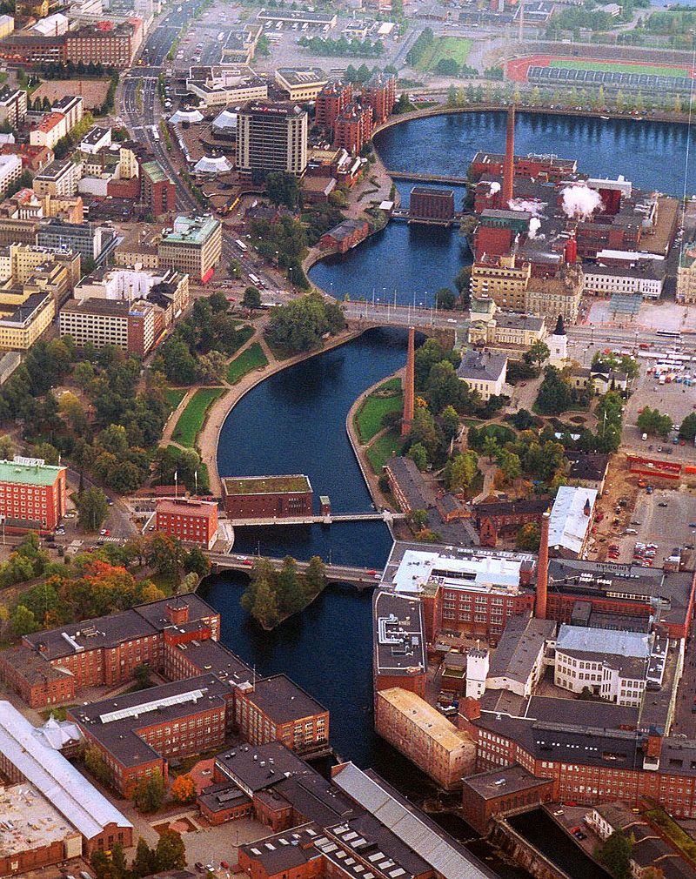
The beginning of Nokia 1865-1902
The Finnish forest industry started to develop rapidly in the mid 19th century.
Mining engineer Fredrik Idestam established a wood pulp mill in Tampere, southwestern Finland.
Fredrik Idestam
https://en.wikipedia.org/wiki/History_of_Nokia
Tammerfors https://fi.wikipedia.org/wiki/Tammerkoski#/media/Tiedosto:Tammerkoski_from_air_2.jpg
An example of a wood pulp mill in Tampere. https://fi.wikipedia.org/wiki/Puuhiomo

Slide 6
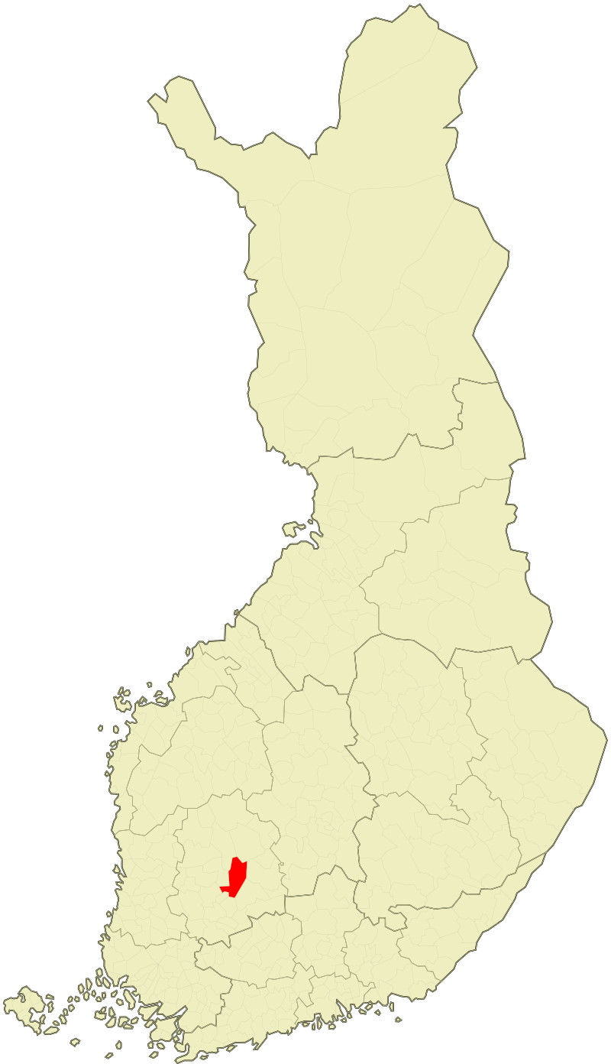
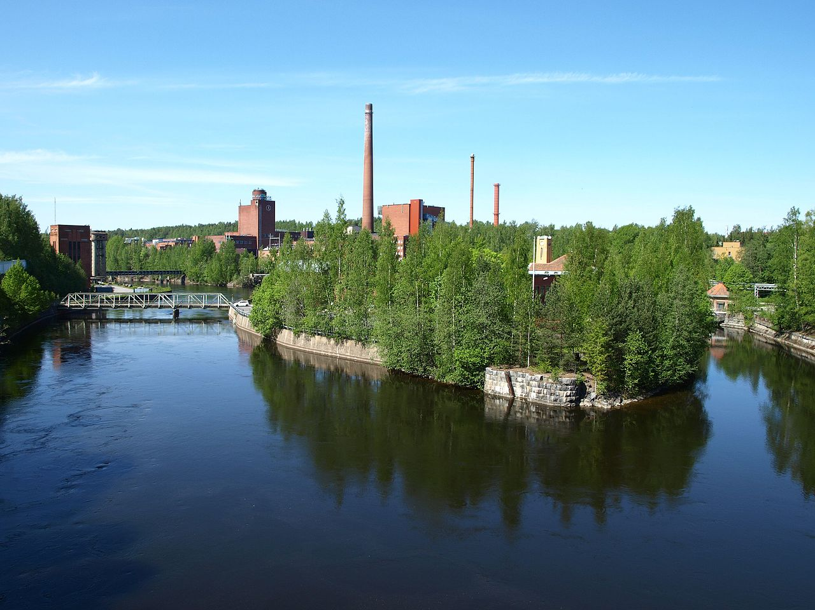
The beginning in the town of Nokia
In 1868 Idestam built a second mill near the town of Nokia.
The name "Nokia" is derived from the town Nokia and the Nokianvirta River.
Nokia lies 15 kilometres (9.3 miles) west of Tampere, by the Nokianvirta river.
The river had better hydropower resources than those in Tampere.
Nokia
Nokianvirta nowadays https://fi.wikipedia.org/wiki/Nokianvirta#/media/Tiedosto:Nokianvirta1.jpg

Slide 7
Nokia Ab
In 1871 Nokia Ab was born.
After Idestam the company expanded into electricity business.
In 1902 Nokia commenced electricity generation.
https://fi.wikipedia.org/wiki/Nokia_(yritys)#/media/Tiedosto:Nokian_logo_(1865).svg

Slide 8
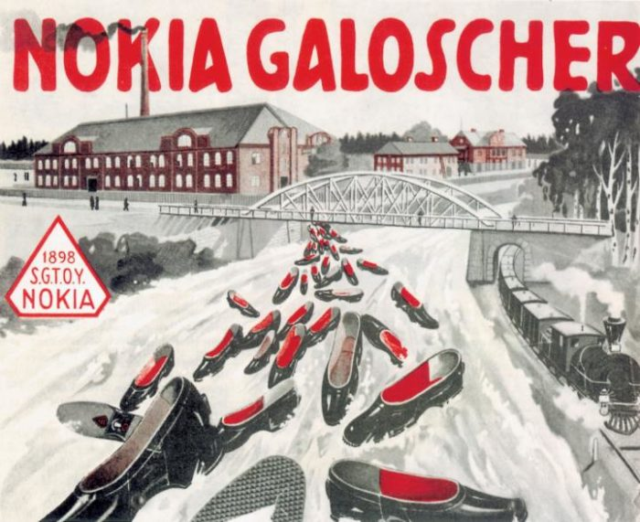
Nokia Ab and two different companies cooperated in the beginning of 20th century
New inventions landed in Finland. Electric power began to enter Finnish homes in the 1910s and home electronic appliances began to develop.
Nokia Aktiebolag had big financial problems.
Another company Suomen Gummitehdas Oy (Finnish Rubber Works) bought Nokia Ab to get energy for factories. The Finnish Rubber Works manufactured galoshes and other rubber products like car tires.
https://finland.fi/business-innovation/nokias-tradition-of-adaptability/

Slide 9
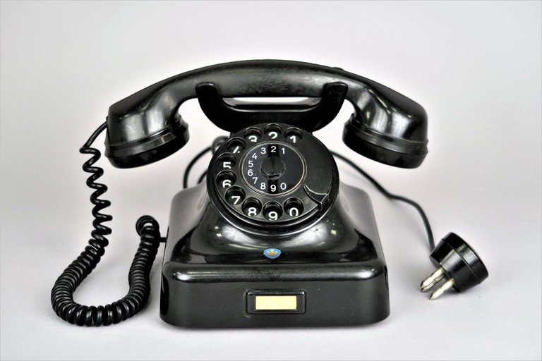
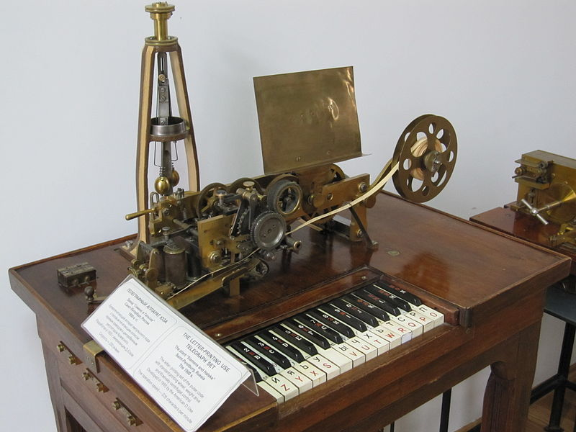
Nokia Ab and two different companies cooperated in the beginning of 20th century
In 1932 the Finnish Rubber Works also acquired the Suomen Kaapelitehdas Oy (Finnish Cable Works). The company produced telephone, telegraph and electrical cables.
Telephone manufactured in 1930-1940. Helsingin kaupunginmuseo https://www.finna.fi/Record/hkm.HKMS000005:00000jvt
Letter-Printing Telegraph Set built by Siemens and Halske in Saint Petersburg, Russia, ca.1900
https://commons.wikimedia.org/wiki/File:Printing_Telegraph.jpg#/media/File:Printing_Telegraph.jpg

Slide 10
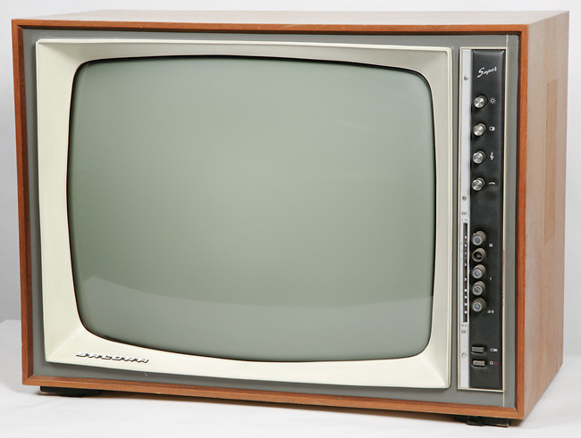
Nokia Corporation was founded in 1967
The three branches of the company (paper, rubber and cables) united and the reshaped company became Nokia Corporation; by then, the implication of Nokia in the electronics segment was remarkable.
In 1964 Nokia VHF radio developed in collaboration with the Finnish company Salora Oy; many analysts consider this step the beginning of telecommunications.
It would anyway be the seed of the ARP standard (AutoRadioPuhelin, ‘Car radio’), which was the first mobile phone network in Finland in 1971.
Salora television 1967 https://www.finna.fi/Record/musketti_lahti.M44:RTMRTME2181:

Slide 11
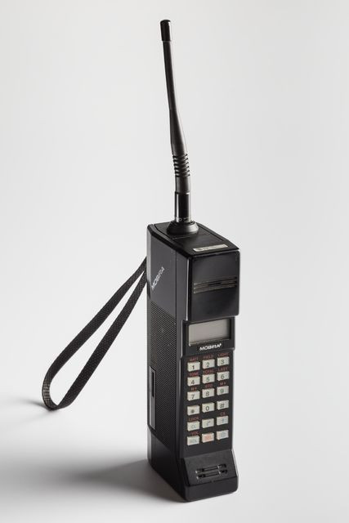
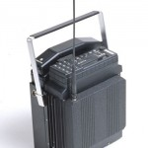
Revolution of communication began in 1980’s: first NMT phones
Nokia manufactured one of the first mobile phones, Cityman Mobira 900 ‘only’ weighing 800 grams.
This was much lighter than the first car device, the Mobira Senator, which weighed 9.8 kg when it was launched in 1982.
The price of the first phone was astronomical: 24,000 Finnish Marks, which would be the actual equivalent of € 9,000.
Mobira Cityman 900, 800 g
In 1987, the Soviet leader Mikhail Gorbachev was seen using a Mobira Cityman in Helsinki. The phone got its nickname, the "Gorba". https://www.finna.fi/Record/musketti.M012:K12015:47
Nokia Mobira Senator, 9.8 kg http://nokiamuseum.info/category/launching-year/1982/

Slide 12
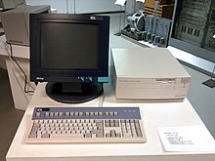
International roaming and personal computers
Nokia contributed to the development of the GSM 2G. It was able to carry data (computing) as well as voice traffic.
Nordic Mobile Telephony (NMT) was an early provider of international roaming.
In 1987, GSM 2G became the new European standard for digital mobile technology.
In the 1980s, Nokia's computer division "Nokia Data" produced a series of personal computers called the "MikroMikko". It was aimed at the business market.
Nokia had many names at that time: Nokia-Mobira in year 1984 and Nokia Mobile Phones in 1989.
MikroMikko https://fi.wikipedia.org/wiki/MikroMikko

Slide 13
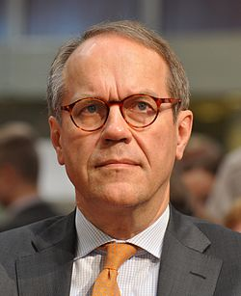
Nokia became the biggest mobile phone company in the world in 1990’s
In 1992, Jorma Ollila became the CEO.
He decided to turn Nokia into a 'telecom-oriented' company. This strategy proved to be very successful and the company grew rapidly in the following years.
By the mid 1990s, Nokia's supply of mobile telephones could not meet demand.
Between 1996 and 2001, Nokia's revenue increased from 6.5 billion euros to 31 billion euros and between 1998 and 2012, Nokia was the world's largest mobile phone manufacturer.
Jorma Ollila served as the CEO of Nokia 1992-2006 and the Chairman of the Board 1999-2012. https://upload.wikimedia.org/wikipedia/commons/6/67/Jorma_Ollila_2013.jpg

Slide 14
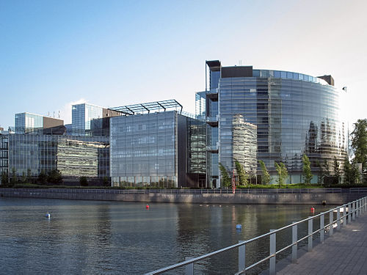
Nokia became the biggest mobile phone company in the world in 1990’s
Nokia had and still today has a huge impact on the Finnish national economy. Nokia was a significant employer and tax payer in Finland.
By 2000 Nokia employed over 55,000 people and had a market share of 30% in the mobile phone market, almost twice as large as its nearest competitor, Motorola.
The company was operating in 140 countries as of 1999.
The former Nokia headquarters in Espoo Keilaniemi https://fi.wikipedia.org/wiki/Nokia_(yritys)#/media/Tiedosto:Nokia_HQ.jpg

Slide 15
1991 first GSM phone the Nokia 1011
The company launched its first GSM phone, the Nokia 1011. The nomenclature chosen had a simple explanation: it was the date of its launch, November 10.
On 1 July 1991, in Helsinki, the first telephone call on the GSM G2 network was made by Harri Holkeri, the Prime Minister of Finland. He used a prototype Nokia GSM phone to make the call.(video).
Nokia 1011 https://fi.wikipedia.org/wiki/Nokia_(yritys)#/media/Tiedosto:Nokia_HQ.jpg

Slide 16
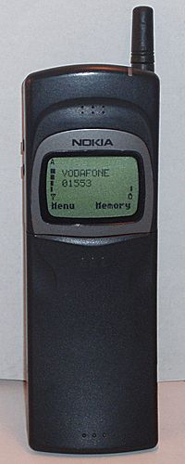
Famous ringtone and game
1994 Nokia ringtone
The famous Nokia ringtone made its debut in 1994 with the 2100 series. The tune is based on the Gran Vals, a piece of classical music composed by Spanish guitarist Francisco Tarrega in the 19th century.
1997 Snake game
In 1997 the Nokia 6110 was launched, and with it, one of the distinguishing features of the legendary first Nokia handsets: the legendary game Snake, distant precursor of all mobile games.
Logo (1992) source: Wikipedia
Nokia 8110 (released in 1996) was used in Matrix movie. ^{source: Wikipedia}

Slide 17
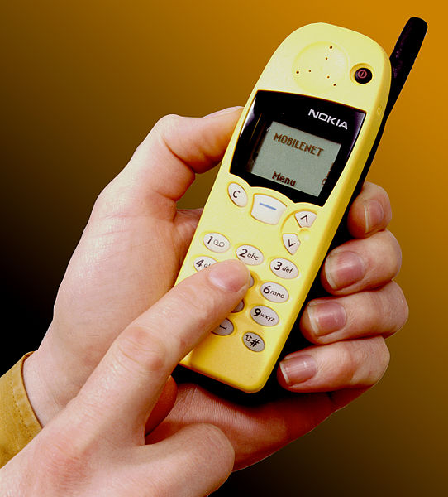
1998 Nokia overtook Motorola
In October 1998 Nokia overtook Motorola to become the best-selling mobile phone brand and in December manufactured its 100 millionth mobile phone.
A major reason why Nokia grew against its main competitors Motorola and Ericsson was that it managed to cater to the consumer youth market and fashion-oriented consumers, most significantly with the Nokia 5110 and 3210 handsets which featured a large range of colourful and replaceable back-covers called Xpress-on.
Nokia 5110 https://commons.wikimedia.org/wiki/File:CSIRO_ScienceImage_2936_Nokia_mobile_phone.jpg

Slide 18
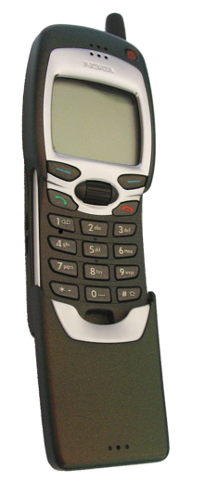
1999 WAP: the pioneer in web browsing
With Nokia as world leader in the mobile phones segment, Nokia 7110 was launched as the first terminal offering basic skills in web browsing (via WAP) and sending and receiving emails. That model was a revolution for its keyboard deck.
Wireless Application Protocol (WAP) is a technical standard for accessing information over a mobile wireless network. A WAP browser is a web browser for mobile devices such as mobile phones that uses the protocol.
Introduced in 1999, WAP achieved some popularity in the early 2000s but by the 2010s it had been largely superseded by more modern standards.
The evolution of Nokia was then unstoppable and achieved great breakthroughs. The company was an innovative maker of camera phones and phones with the possibility of recording videos.
Nokia 7110 https://fi.m.wikipedia.org/wiki/Tiedosto:Nokia_7110_open.png

Slide 19
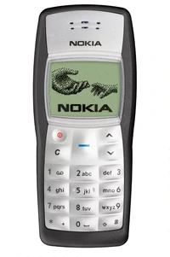
Beginning of the 21st century: 3G and new challenges
The arrival of the 3G network to Nokia phones happened in 2002. Nokia 1100 (released in 2003) was the best selling mobile terminal in history with over 250 million units.
In 2004 Nokia made large organisational reforms which led to a competitive situation between different departments inside the company. This situation had a large impact on Nokia’s ability to compete with others in the market.
Nokia 1110 https://nokia.fandom.com/wiki/Nokia_1100

Slide 20
Apple iPhone & touch screen overcomes Nokia
A newcomer entered the market 2007: the first Apple iPhone.
Nokia failed to prepare in subsequent years for an era in the world of mobility in which the most relevant loomed software.
Apple iPhone had modern features such as touch screen.
Nokia had difficulties to create an operating system (Symbian, Linux-based MeeGo) which would have been able to compete with other companies producing smartphones.
iPhone 3
By Rafael Fernandez CC BY-SA 4.0, https://commons.wikimedia.org/w/index.php?curid=63395591

Slide 21
From 2010 till today: finding new direction
On the 11th February 2011 Nokia announced a "strategic partnership" with Microsoft, under which it would adopt Windows Phone 7 as its primary operating system on smartphones, and integrate its services and platforms with its own.
Falling sales in 2011 led to huge losses. By mid-2012 the company's stock price fell below $2.
Nokia ended up firing lots of its employees.
Many of Nokia’s former employees in Finland have started up new businesses and innovations.

Slide 22
Nokia nowadays
Nokia bought Alcatel-Lucent in 2016 and it was the biggest transaction in the history of Finland.
Nowadays Nokia is concentrating on developing better networks, for example 5G and other new technologies.

Slide 23
Sources
Wikipedia. https://en.wikipedia.org/wiki/Nokia
NokiaMuseum.http://nokiamuseum.info/nokia-phones-collection/page/87/
Nokia. https://www.nokia.com/about-us/what-we-do/our-history/
Mobileworld capital. https://mobileworldcapital.com/2013/09/28/179/

Slide 24
Credits
Presentation template by SlidesCarnival
Illustrations by Sergei Tikhonov

